Slide 1
Machine Learning - Made Simple
Kishan Joshi (@joshi98kishan)
joshi98kishan@gmail.com

Slide 2
Slides posted on
Twitter @joshi98kishan

Slide 3
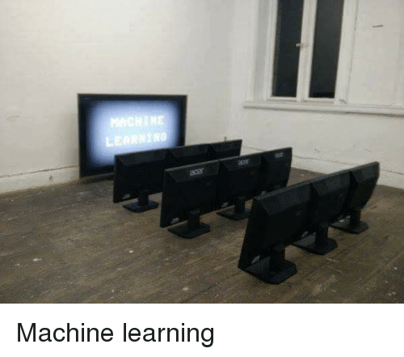

Slide 4
Note:
Focus primarily on Data Structure and Algorithm, because
“DS and Algo important hai”.
ML is just a add-on skill, which you can do in your free time.

Slide 5
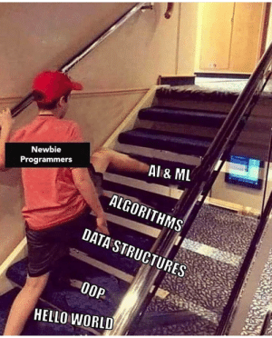

Slide 6
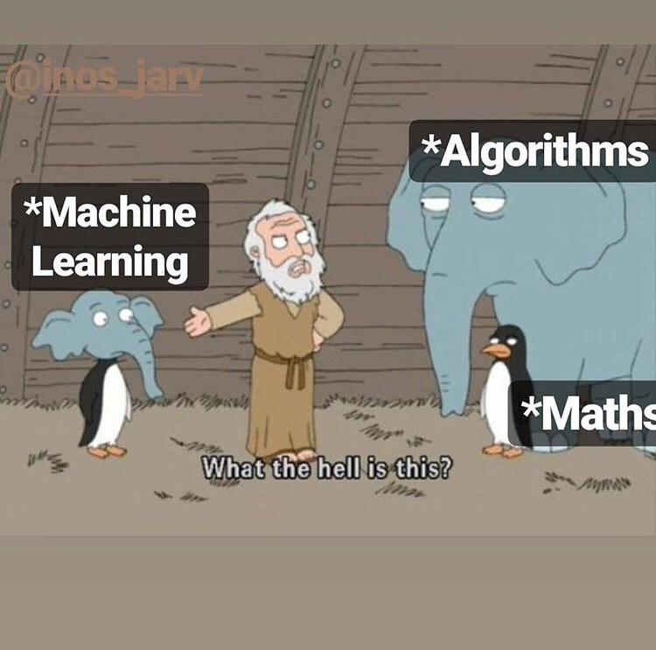

Slide 7
History of Machine Learning
1952 - Arthur Samuel wrote the first ML program that taught computer to play game of checkers all by itself.
1959 - Machines learned to make phone calls clearer.
1985 - Machines learned to pronounce new words.
1997 - Deep blue intelligent computer won the chess game against the chess champion Garry Kasparov.
2006 - Geoffrey Hinton named neural network research as deep learning.
2016 - AlphaGo beat the world’s champion at Go game.
...

Slide 8
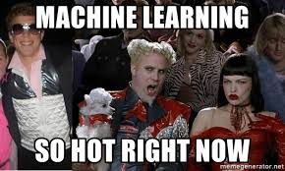

Slide 9
Why machine learning is trending now?
Abundant data
Abundant Computation - Nvidia
...

Slide 10
Real-World
Machine Learning Applications

Slide 11
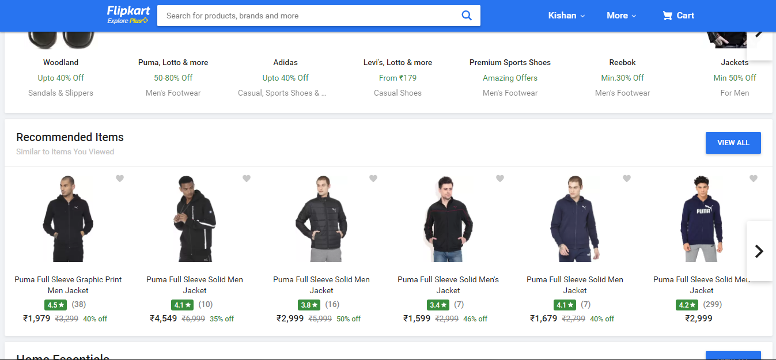
Product Recommendations

Slide 12
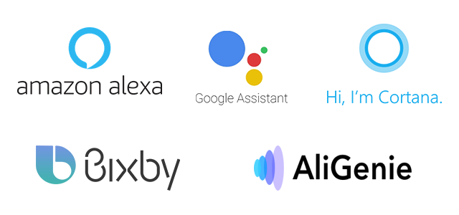
Virtual Assistant

Slide 13
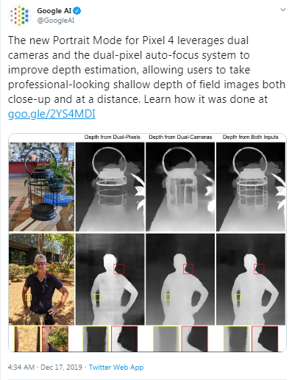
Portrait Mode

Slide 14
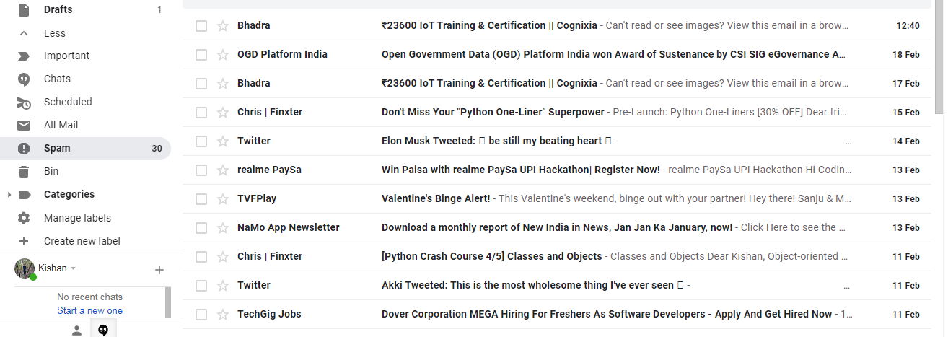
Spam Filtering

Slide 15
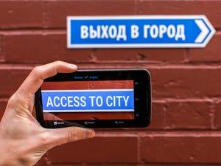
Language Translation

Slide 16
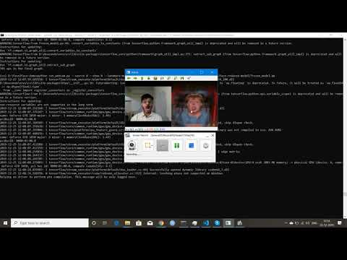
Deep Fake

Slide 17
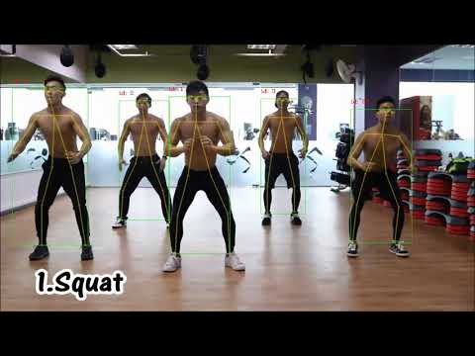
Gym Pose Estimation

Slide 18
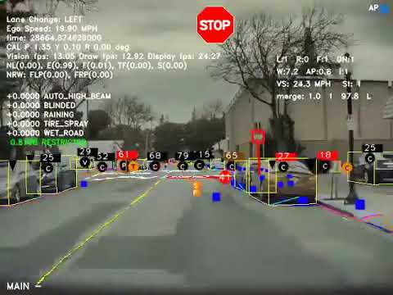
Self Driving Car

Slide 19
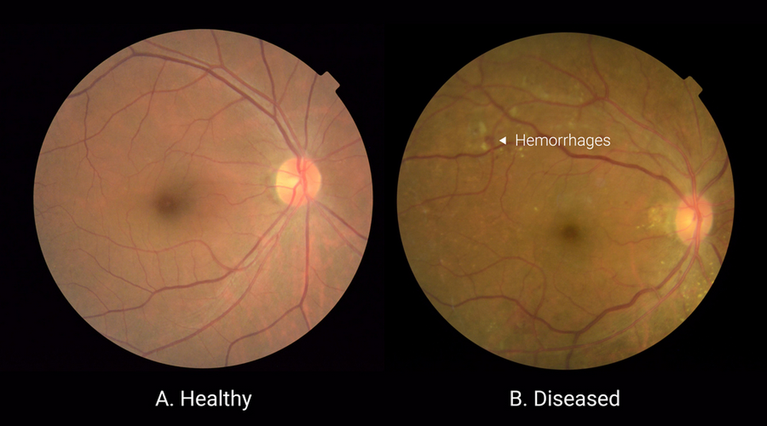
Blindness Detection

Slide 20
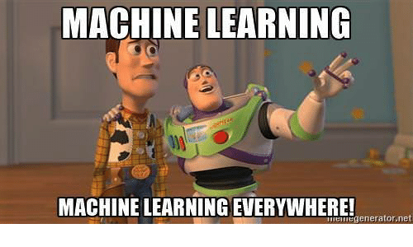

Slide 21
Traditional Programming
vs
Machine Learning

Slide 22
Fizzbuzz with Traditional Programming
def fizzbuzz(n):
if n % 3 == 0 and n % 5 == 0:
return 'FizzBuzz'
elif n % 3 == 0:
return 'Fizz'
elif n % 5 == 0:
return 'Buzz'
else:
return 'Other'

Slide 23
y = f(x)
x
f
y
(Integer)
{ ‘Fizz’,
‘Buzz’,
‘FizzBuzz’,
‘Other’ }

Slide 24
Fizz
Buzz
12
10
99
95
66
65
102
100
18
20
69
65
f(150) = ?
FizzBuzz
Other
15
1
75
97
135
53
105
67
90
68
45
71

Slide 25
Fizzbuzz with Machine Learning
Get the training data and testing data.
Data preprocessing
Build a model
Train the model
Evaluate the model

Slide 26
Training Data
Input | Output (Label)
101 | Other
110 | Buzz
981 | Fizz
990 | FizzBuzz
1000 | Buzz
... | ...

Slide 27
Data Preprocessing
Input | Output (Label)
101 | 3
110 | 1
981 | 0
990 | 2
1000 | 1
Label | Encoded Label
Fizz | 0
Buzz | 1
FizzBuzz | 2
Other | 3
... | ...

Slide 28
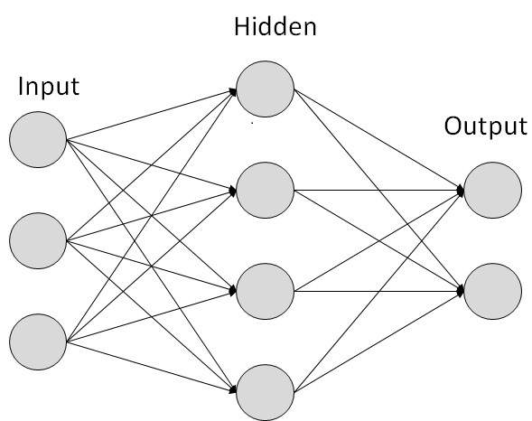
Build a model
Select the function according to your problem
Function1
Function 2
...
Input
(-∞, +∞)
Input
{ C1,
C2,
… }
Universal Function
We will select the function 2, as we need output in the form of classes
Function 2
Input
(A Integer)
{ Fizz, Buzz, FizzBuzz, Other }

Slide 29
Note : In Machine Learning, we refer function as a model. So, instead of calling it a function we will call it a model.

Slide 30
Train a model
Input | Output (Label)
101 | 3
110 | 1
981 | 0
990 | 2
1000 | 1
True Output
Model 2
Check if model has given correct output
Predicted
Output
(e.g. 2)
Input
(e.g 101)
... | ...
Feedback

Slide 31
Evaluate a model
Input | Output (Label)
99 | 0
50 | 1
28 | 3
15 | 2
10 | 1
True Output
Model 2
Accuracy
Predicted
Output
(e.g. 2)
Input
(e.g 101)
Total number of correct predictions
Accuracy
... | ...
Total number of samples

Slide 32
Notebook

Slide 33
Chatbot with traditional programming
Set up the entire vocabulary
Figure out the grammatical rules
Divide the vocabulary into nouns, verbs and whatever parts of speech there are.
Define different rules of sentence structuring for different kinds of tenses.
...

Slide 34
Chatbot with Machine Learning
Get the training data and testing data.
Feature Extraction
Build a model
Train the model
Evaluate the model

Slide 35


Slide 36
Traditional Programming
Traditional Programming
Data
Answers
Rules

Slide 37
Machine Learning
Machine Learning
Data
Rules
Answers

Slide 38
Which to choose?
It is all depend on the problem,
If the problem is solvable with traditional programming in a easy way, then go for it.
Otherwise try to solve it with machine learning.
Note: ML doesn't give accurate results, it utilize lot of computation power, takes time for training.

Slide 39
Machine Learning

Slide 40
Definition
“Machine Learning is the field of study that gives computers the capability to learn without being explicitly programmed. ”
“A computer program is said to learn from experience E with respect to some class of tasks T and performance measure P if its performance at tasks in T, as measured by P, improves with experience E”

Slide 41
Types of ML Algorithms
Supervised
Unsupervised
Semi-Supervised

Slide 42

Supervised Algorithms

Slide 43

Unsupervised Algorithms

Slide 44
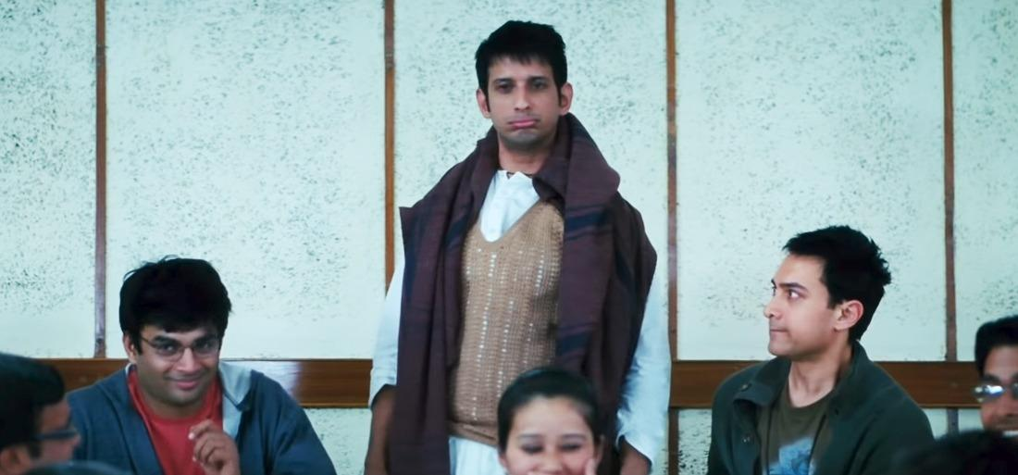
Semi-Supervised Algorithms

Slide 45
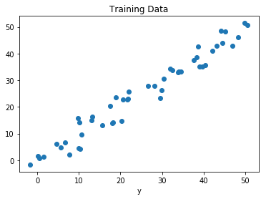
Regression : Supervised Algorithm Example
Surface Area (Sq. Feet) | Price (Lakhs)
100 | 35
150 | 50
160 | 55
900 | 100
57 | 20
Price
Surface Area
... | ...

Slide 46
Regression : Supervised Algorithm Example
Function1
Input
(-∞, +∞)
Price
Surface Area

Slide 47
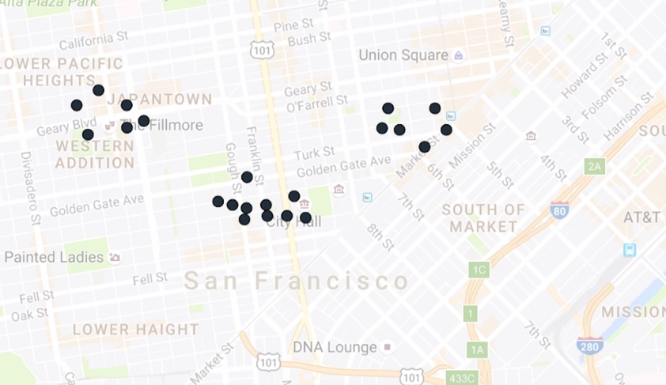
Clustering : Unsupervised Algorithm Example

Slide 48
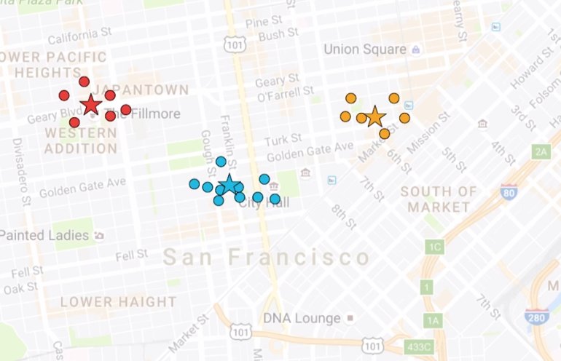
Clustering : Unsupervised Algorithm Example

Slide 49
Which kind of problem can be solved by Machine Learning?
Historical data exists in a huge amount.
A pattern exists in the data.
Extremely hard to pin down a solution mathematically.

Slide 50
Career in Machine Learning
All the companies are shifting to machine learning, and hence there is a very high demand for machine learning experts in the industry.
The entry level average salary in India is : Rs. 9.5 Lakhs per year
(For Machine Learning Engineer role)
As experience in the field increases, the salary package also increases and can range somewhere
Rs. 15 Lakhs– 50 Lakhs per year.

Slide 51
Prerequisites
Linear Algebra - Most Important
Probability
Statistics
Calculus
Note: Have only general knowledge of above topics for beginners, which is generally covered in schools.
But for advance ML, you must know this topic at deeper level.
ML is the mathematics.
So, for beginners you don’t need to study maths, because you already know it.

Slide 52
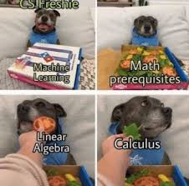

Slide 53
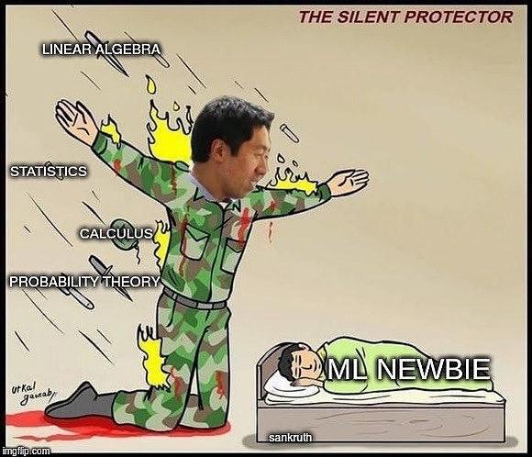
Roadmap
Stanford’s Machine Learning Course

Slide 54





Roadmap (Cont.)
2. Now, Install Anaconda.
...

Slide 55

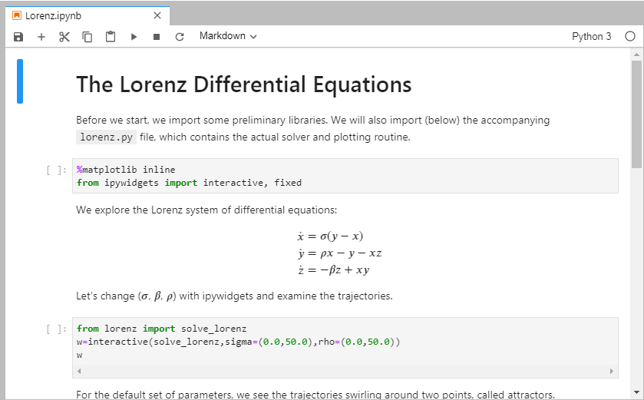
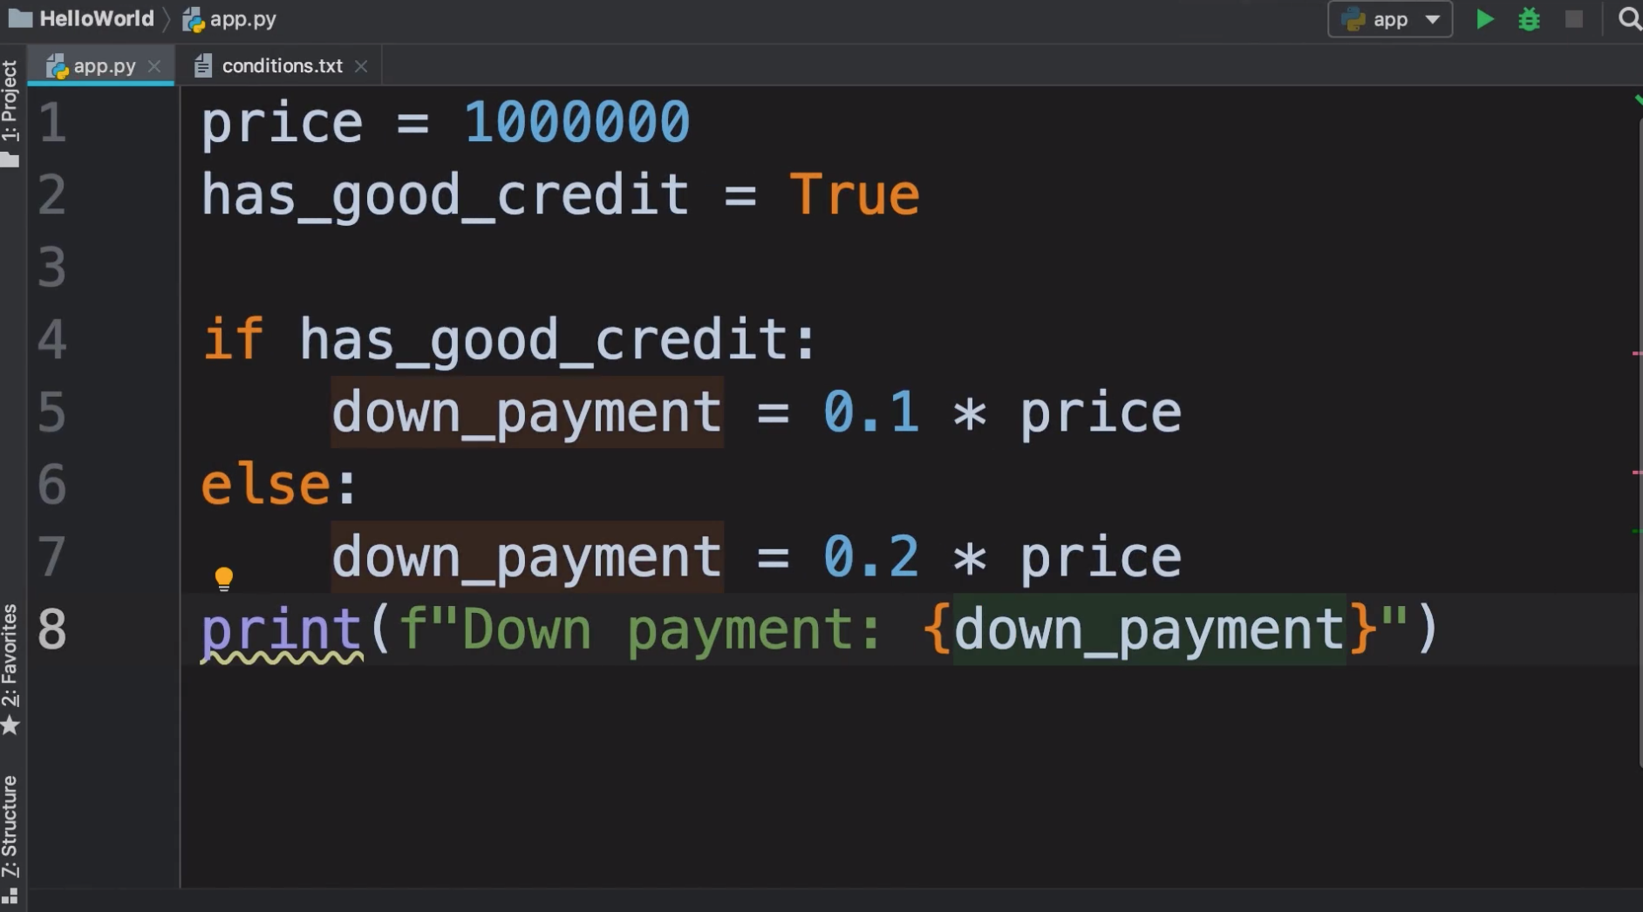
Roadmap (Cont.)
Have a overview of Jupyter-Notebook
Documentation
Code

Slide 56
Roadmap (Cont.)
3. IBM’s Machine Learning with Python course.
4. Learn libraries more comprehensively.
5. University of Washington’s Machine Learning Specialization

Slide 57


Roadmap (Cont.)
6. Solve Getting-Started problems on Kaggle.

Slide 58


Roadmap (Cont.)
7. Now select your own problem.

Slide 59



Roadmap for Deep Learning
1. deeplearning.ai’s Deep Learning Specialization.
2. fast.ai’s Practical Deep Learning for Coders.
3. Learn libraries for deep learning.

Slide 60
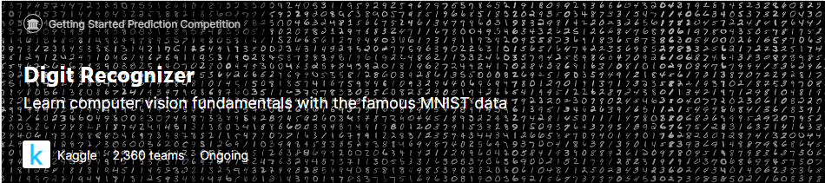
Roadmap for Deep Learning
4. Solve Getting-Started problem on Kaggle.

Slide 61
Roadmap for Deep Learning
5. Now select your own problem.

Slide 62
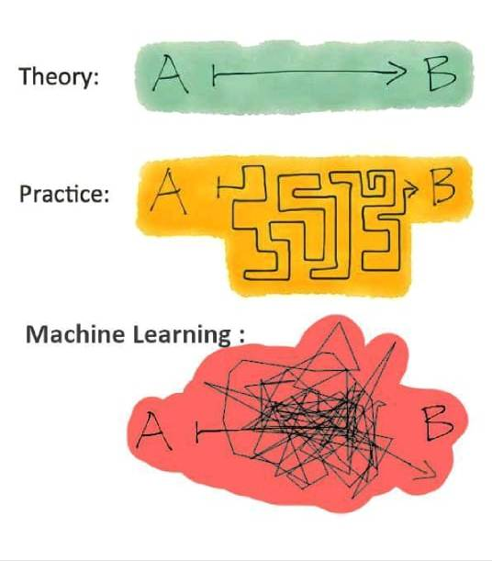

Slide 63
Libraries for Machine Learning
Numpy - Most Important
Pandas
Matplotlib
Sklearn
Tensorflow
Pytorch

Slide 64
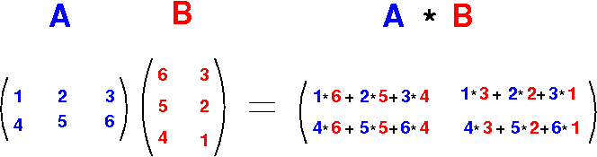
Numpy
For Linear Algebric operations

Slide 65
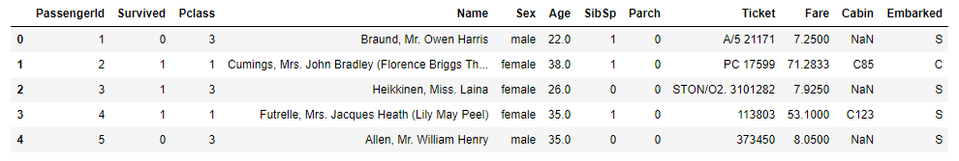
Pandas

Slide 66
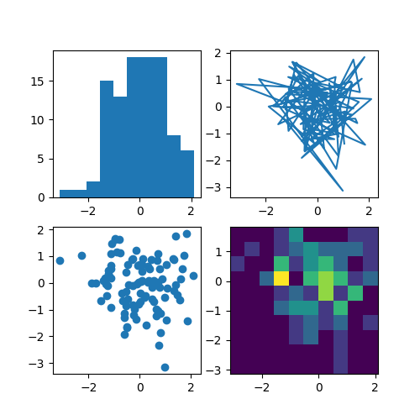
Matplotlib

Slide 67
Sklearn
Function1
Input
(-∞, +∞)
Function 2
Input
{ C1,
C2,
… }
Universal Function
...

Slide 68
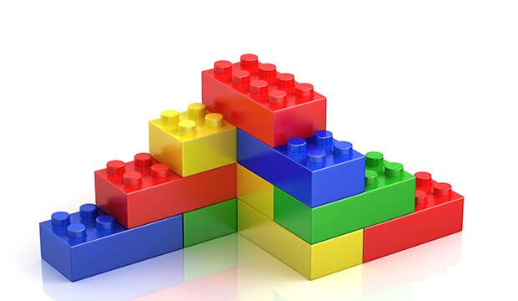
Keras

Slide 69
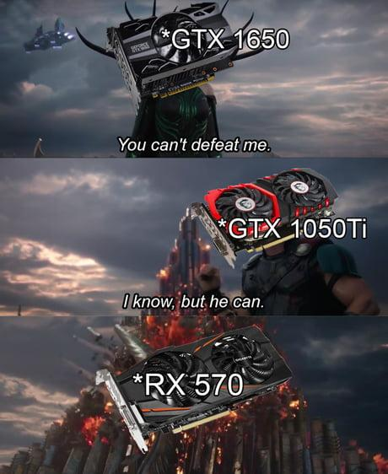
Tensorflow and Pytorch

Slide 70


Slide 71
Future Plans !!!!!!!
Series of workshops on Machine Learning starting from Python to Deep Learning.

